Slide 1
Modernization Microsoft Cloud WorkShop OSS Paas & DevOps
Jivane Rajabaly PreSales Engineer
Francois-Xavier Kim PreSales Engineer
Notes:
For some time now, the buzzword on everybody’s lips when it comes to innovation has been Digital Transformation.
Do a web search, and you will find a plethora of quotes and citations about the need to change how business is done today by thought leaders, CEOs and assorted business gurus.
The common thread that runs through all of these quotes is that Digital Transformation isn't just for Silicon Valley companies or young startups anymore.
It's a way of life for organizations looking to survive in the next decade.

Slide 2
Agenda
09h00 - 09h30 : Accueil et introduction
09h30 - 10h30 : Modernisation des applications et Open Source Hands on component
Azure, OSS @Microsoft + ModernApp Option in Azure + DevOps
10h45 - 12h15 : WhiteBoard Session "Containers & DevOps"
12h30 - 13h30 : Déjeuner
13h30 - 15h30 : Hands On Lab Modernisation des Apps avec les container"
15h45 - 16h45 : Hands On Lab "Mise en place de CI/CD"
16h45 - 17h00 : Conclusion

Slide 3
Logistique
Dej / Téléphone / Pause / Café / Boisson / Internet

Slide 4
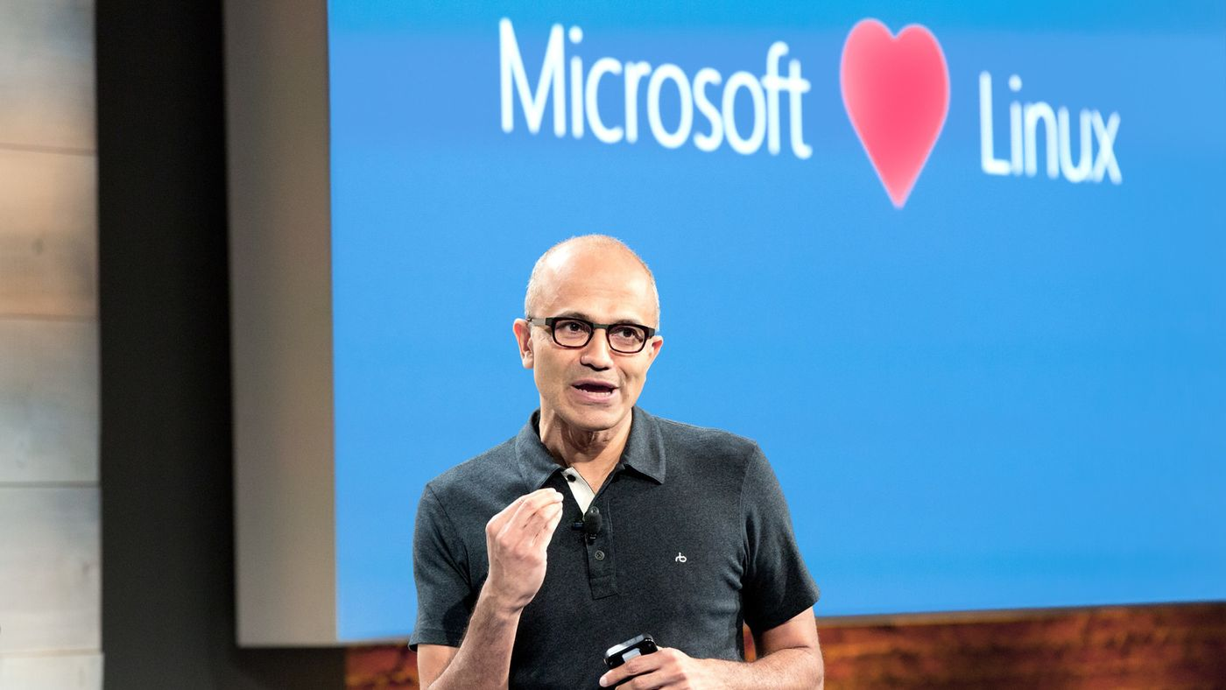
“Judge us by the actions we have taken in the recent past, our actions today and in the future”
—Satya Nadella, CEO Microsoft
2014
2018
2015
2016
2017

Slide 5
Why open source?
> 40%
>40% CIOs have open source as primary software strategy
> 60%
>60% of developers want to see cloud providers involved in OSS
90%
90% of enterprise deploy open source in some form
Forrester 2017, Microsoft CMR, Altoros 2016-2017 trends in Open Source

Slide 6

Azure
Open Source
Notes:
Hiring – each and every new technical hire needs to have OSS skills…
Get comfortable, get fluent
Please communicate this to your teams

Slide 7
GitHub contributions
“Judge us by the actions we have taken in the recent past, our actions today and in the future”
—Satya Nadella, CEO Microsoft
2018
VS Code ranked #1 developer tool
Service Fabric Open Sourced
Azure Sphere with Linux kernel
GitHub intent to acquire announced
~5,000 Microsoft employees committing to open source projects on Github
Azure trending to 50% Linux
2017
Microsoft Azure Kubernetes Service launched
Draft, Brigade, Kashti projects submitted to Kubernetes community
Microsoft joins Cloud Native Computing & Cloud Foundry Foundations
Azure Database for Postgres & MySQL announced
Azure Databricks (Apache Spark) announced
2016
.NET Core 1.0
PowerShell Core
SQL on Linux announced
Windows Subsystem for Linux in Windows 10
Microsoft joins Linux foundation
2015
VS Code released
HDInsight (Hadoop/ Ubuntu) announced
Microsoft jointly forms Node.js foundation
2014
Satya “Microsoft loves Linux”
.NET foundation created
95,539
314,546
601,886
778,871
314,970 (YTD)
2014
2015
2016
2017
2018

Slide 8
GitHub contributions
2018
VSCode ranked #1 developer tool (Stack Overflow, 2018 language survey)
Service Fabric Open Sourced
Azure Sphere with Linux kernel
GitHub intent to acquire announced
~5,000 Microsoft employees committing to open source projects on Github
Azure trending to 50% Linux
2017
Microsoft Azure Kubernetes Service launched
Draft, Brigade, Kashti projects submitted to Kubernetes community
Microsoft joins Cloud Native Computing & Cloud Foundry Foundations
Azure Database for Postgres & MySQL announced
Azure Databricks (Apache Spark) announced
2016
.NET Core 1.0
PowerShell Core
SQL on Linux announced
Windows Subsystem for Linux in Windows 10
Microsoft joins Linux foundation
2015
VSCode released
HDInsight (Hadoop/ Ubuntu) announced
Microsoft jointly forms Node.js foundation
2014
Satya “Microsoft loves Linux”
.NET foundation created
95,539
314,546
601,886
778,871
314,970 (YTD)
2014
2015
2016
2017
2018

Slide 9
Contribute
Microsoft contributes code and thought leadership to open source communities, engaging developers as developers
Innovate
Microsoft releases key innovations as open source for others to use and build upon
Enable
Azure enables every developer and organization to more easily adopt open source in the cloud, without having to be an expert

Slide 10
Innovate
Microsoft releases key innovations as open source for others to use and build upon
“
I know it's very, very hard for some of you to believe it, but Microsoft really and truly is well on its way to becoming an open-source company.”
Microsoft open sources powerful developer tools—VS Code is the #1 most popular editor for developers in any language
Microsoft creates new open source languages. R, TypeScript, and PowerShell are all top ranked open source languages with origins linked to Microsoft
Azure open sources key cloud infrastructure components. Service Fabric and acs-engine released as open source
Microsoft is a leading Linux innovator, ranked as a top contributor to the Linux Kernel
Why Microsoft is turning into an open source company
Steven J. Vaughan-Nichols, ZDNET

Slide 11
Contribute
Microsoft contributes code and thought leadership to open source communities, engaging developers as developers
Innovate
Microsoft releases key innovations as open source for others to use and build upon
Enable
Azure enables every developer and organization to more easily adopt open source in the cloud, without having to be an expert

Slide 12
Contribute
Microsoft contributes code and thought leadership to open source communities, engaging developers as developers
“
Today [Microsoft] is demonstrating some impressive traction when it comes to open source community contributions. If we are to judge the company on its recent actions, the data shows what Satya Nadella said in his announcement about Microsoft being “all in on open source” is more than just words.”
Microsoft has more engineers developing in the open on Github than AWS, with about 5,000 Microsoft employees committing to opens source projects making more than 2 million commits
Microsoft employees commit to other people’s projects contributing code to more than 8,000 non-Microsoft projects
Microsoft collaborates on open source development with other organizations via foundations like the .NET Foundation, Linux Foundation, CNCF, and more
Microsoft builds communities; more than 19,000 developers from over 3,700 companies have contributed to .NET Core and related open source repositories
The data behind Microsoft’s surprising open source track record
Donald Fischer, Tidelift

Slide 13
Contribute
Microsoft contributes code and thought leadership to open source communities, engaging developers as developers
Innovate
Microsoft releases key innovations as open source for others to use and build upon
Enable
Azure enables every developer and organization to more easily adopt open source in the cloud, without having to be an expert

Slide 14
Enable
Azure enables every developer and organization to more easily adopt open source in the cloud, without having to be an expert
“
As the transformation to a Cloud-first organization took hold at Microsoft, the commitment to open source really took hold….open-source toolsets really find first-class citizenship within the Azure platform.”
Azure makes open source projects easier to use by improving their security and manageability, while preserving open APIs. Kubernetes, MySQL, Postgres, Redis Cache, Spark and more, all as native managed Azure services with full open API compatibility and integrations with Azure security and monitoring
Azure provides enterprise support, and a large partner ecosystem. From embedded ISV support partners like Red Hat, to implementation partners, the Azure ecosystem can provide whatever help you need
10th Magnitude, Azure Partner of the Year, 2018

Slide 15
POLL: Which one of these will land best with your customers?
Messaging success
Innovate
We open source technology we build
Contribute
We contribute code to other people’s projects
Enable
We improve open source, make it more secure and manageable
We have a large partner ecosystem

Slide 16
Why open source?
Customer reality…
Devs want to see
Our approach is differentiated and helps support partners and enterprise

Slide 17
Applications fuel digital transformation
Engage your customers
Transform your products
Apps
Digital Transformation
Enable your employees
Optimize your operations
Notes:
App Innovation fuels digital transformation
Digital transformation is top-of-mind for every business, regardless of industry, shape, and size.
Whether it’s to engage with customers in new and innovative ways, to transform and differentiate their products, to create efficiencies in operations, or to empower a new generation of millennials in the workforce.
Businesses are embracing new technologies at a pace never seen before so that they can remain relevant and stay ahead of their competition.
And in doing so, organizations of all sizes across industries are realigning their business around digital experiences, because they realize that the majority of interactions with customers, employees, and partners going forward will happen through apps and other digital channels.
And as the business world moves into the digital space—to meet the next generation of customers, employees, and partners; to create new efficiencies; and to compete globally—apps, and specifically innovation through apps, is central to their strategy.
We call this app innovation, and we see it at the core of every digital transformation journey.

Slide 18
Widening digital divide between Business and IT
Business needs
IT challenges
Rapid innovation to transform products
Connect with customer and empower employees
Close the gap from data to decision
72% 1 budget assigned to keep-the-lights-on functions
Demand for mobile apps >5x the capacity of IT
Only half decision makers could get help from technologists with their analysis needs 2
Notes:
With the accelerating pace of change around us, every business needs to innovate & change faster than ever before
Old infrastructure and traditional ways of building apps are becoming growth inhibitors for an enterprise
Business need rapid innovation – to rollout out new business models, optimize business processes, respond to regulations
72% of IT budget is dedicated to keep-the-lights-on functions which doesn’t leave whole lot for new projects
Businesses need their employees to be productive on the go. And everyone wants to be able to connect to their LoB systems, regardless of whether they are old are new, through mobile devices
Demand for mobile apps is 5x the capacity of IT
Business leaders want their employees to make decisions faster which requires friction free access to data, reporting and analysis.
For many traditional IT departments, this creates an endless churn of building reports – taking precious resources away from new development initiatives and still not being able to meet the reporting needs of business
These are just some examples illustrating the widening digital divide between Business and IT
And today we’re going to show you how you can address these challenges & transform your internal business apps leveraging the strengths of IT and business (power users)
Shadow IT. Security concerns
Source 1. Data source: Forrester IT Survey, 2013
Forrester Research survey of IT leaders at more than 3,700 companies, respondents estimated that they spend an average 72% of the money in their budgets on such keep-the-lights-on functions as replacing or expanding capacity and supporting ongoing operations and maintenance, while only 28% of the money goes toward new projects.
Source 2: Forrester Predicts Investment In Artificial Intelligence Will Grow 300% in 2017. Forrester Research, Inc. November 1, 2016. (Source)
While in 2015 it found that only 51% of data and analytics decision-makers said that they were able to easily obtain data and analyze it without the help of technologist, Forrester expects this figure to rise to around 66% in 2017
===================================================================
Data source: Enterprise Application Trends. Gartner, 2016
By the end of 2017, market demand for mobile app development services will grow at least five times faster than internal IT organizations' capacity to deliver them
http://www.gartner.com/newsroom/id/3076817

Slide 19
Challenges with current applications
Aging infrastructure
Lack of agility
Legacy applications
Operational costs, lower efficiency and reliability
Capital expenditure requirements
Security, audit, and regulatory compliance
Long time to provision resources and deploy
Hard to do rapid dev/test and prototyping
Inflexible, monolithic & highly coupled app design
Highly IT dependent
Hard to compose/integrate across environments
Needs of mobile workforce and data driven innovation
80%
28%
Time spent on administrative tasks
40%
Global IT budgets dedicated to maintenance
Increase of data breach incidents in 2016
Notes:
Now this is a picture that all of us can relate to. We typically have to work with lots of LoB apps. Many enterprises have more than 1,000 LoB systems – You might have a system for budgeting, orders, invoices, approvals and so on. In fact, many companies have multiple systems serving somewhat similar function, say, Approvals. And employees really have to jump from one system to another to get work done or request IT to create mash-up apps that pull data from different systems and create workflows to capture the details as a document moves from one employee to another or from one dept to another.
It is not surprising, almost all employees now expect to access LoB systems from mobile devices which is fueling huge demand for mobile apps in an enterprise. And if they cannot access the data easily, it impacts their productivity. With the changing needs of business, they also request lots of changes and need them sooner than latter.
But lot of these systems are hard to change.
Some of the LoB systems were built10-20 years ago and it goes without saying it is not easy or practical to replace them. They are going to be there for a long time.
Next, there is a wide variety of LoB apps. You still have many companies running their core business processes using Mainframes. For some apps, you might have created custom built apps, or have an ISV solution customized per your organization needs.
Next, you might be hosting some apps in cloud or on-premises.
This makes it hard for IT to maintain and innovate on these apps matching the speed of business. Here are some implications of the state most large enterprises find themselves in:
1st …. 80% of IT budget is spent on maintenance which means there is only 20% left to do something new. You might be thinking about Digital transformation but lots of times will find IT not having sufficient budget to support your request. It is not that IT doesn’t want to move fast but are constrained by budget and resources.
2nd every business leader today wants their organization be more agile. They want their employees should be able to respond faster to end customers, if there is a change you should be able land it fast in the marketplace. This requires your employees to be highly productive but about 28% of their time is spent on administrative tasks such as copying data from one system to another, approving in one system and then into another and so on, or manually driving a business process, or spending time on finding data which might be hiding somewhere in these systems. This creates a huge productivity drag and impacts the agility of your whole enterprise.
3rd Security is top of mind for everyone. Not only you need it for compliance reasons but it is also about customers’ trust. Unfortunately, the number of When customers given their data to you they expect you to keep it secure and that is why data breaches are so costly as they impact your ability to attract and retain customers.
=============================================================================
Data sources:
Cost: http://www.gartner.com/newsroom/id/497088
2) Agility: https://acrobat.adobe.com/content/dam/doc-cloud/en/pdfs/idc-adobe-document-disconnect-whitepaper-global-ue-final.pdf
3) Security: http://www.idtheftcenter.org/2016databreaches.html
=====================================================================================================
Productivity & Agility
Employees spend so much of time searching and gather data vs getting contextual info/data automatically.
It takes far too long to respond to changing business processes or new business requirements
Agility: For achieving agility, there should be a rolling plan in addition to the mid-term or long-term strategic planning document. Need for agility arises due to changes in underlying assumptions. If these changes are captured in the rolling plan, flexibility can be achieved. Every CIO may ask self: Is IT responsive and proactive enough to find answers and solutions in case of emerging chances? Does IT have a platform which is scalable, secure, resilient and well interconnected? IT is now the rate limiter for change, the IT infrastructure that was implemented to deliver business automation in the 20th Century, which it did quite well through standardization, now impedes business agility in the 21st Century; a movement that recognizes increasingly dynamic business environments and the need for operational responsiveness is on the way. Organizations need to adaptive IT infrastructure for business sustainability. This reflects that systems development, qualification, and deployment are complex tasks. The business aspiration to agility can often be leveraged to help align business and technology stakeholders around the case for application modernization and rationalization. Many businesses aspire to agility when they are burdened by brittle, tightly coupled systems constrained by rigid roadmaps and deployment schedules due to the underlying code debt, integration dependencies, and testing complexity. In the meantime, well-run technology organizations can demonstrate alignment by being responsive to tactical business opportunities to the degree possible while remaining focused on developing, communicating, and executing a longer-term strategy to enable and maintain true enterprise agility.
http://futureofcio.blogspot.com/2013/10/how-to-define-it-agility.html
Cost
Legacy applications cost a lot to maintain and more resources to innovate on.
They are result in high cost for the business - to run & operate various business processes.
Security
Having different applications having their own user-id password, creates more points of failure
Lots of data in today’s enterprise in not encrypted

Slide 20


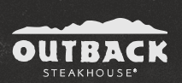
We can helpapplications
Deliver a modern experience on legacy systems
From zero to a full-fledged ecommerce marketplace
Customer Engagement Innovator with rich mobile app
Challenge: Modern experience on top of their LoB apps, 400 systems of record, some are 30 years old
Challenge: we will have to handle millions of customers. That requires a top-class e-commerce system built on a flexible, open cloud platform
Challenge: pain points engaging customers via mobile: add themselves to a wait list, get alerts, pay via mobile phone, and earn points in reward system. The process needs to be streamlined.
Success:
70% infrastructure consolidation
Success:
12 month to build vs 2 years.
Success:
Winner of 2016 Restaurant Breakthrough Award
Notes:
1) Metlife:
Built an application, using containers, that "wrap" the decades worth of legacy systems
The new application was able to tap into these systems of record to access the data and serve it up to both customers and agents alike in a single online experience, while gaining operational scale through cloud infrastructure.
The result:
70% consolidation on infrastructure by moving to Cloud.
IT Agility. Apps built using containers access to legacy systems, serving agents and customers via one app.
Easy deployment anywhere around the globe.
2 https://enterprise.microsoft.com/en-us/customer-story/industries/retail-and-consumer-goods/jet-com/
To be one of the best e-commerce destinations in the US, we will have to handle millions of customers. That requires a top-class e-commerce system built on a flexible, open cloud platform. That is exactly what we got with Azure. From microservices to App
Being able to leverage so many off-the-shelf services and tools from Azure enabled us to go from zero to a full-fledged e-commerce marketplace in just 12 months
Benefits
Working with Microsoft Azure cloud services has provided Jet with a level of flexibility and scalability that has been critical to its aggressive development schedule.
Moving from code to production in minutes.
By using App Service for its consumer front end, Jet has been able to dramatically streamline its development process, so that it can build, deploy, and scale consumer-grade web apps more rapidly. As Hanrahan says, “We’ve been able to get our critical code through our CI/CD process in a couple of minutes using App Service.”
Scaling automatically to meet customer demand
As with any popular e-retailing site, Jet requires extremely rapid and flexible scaling based on ever-changing customer traffic. To streamline this process, Jet was able to set up auto-scaling on both PaaS servers and App Service to scale its servers based on load or schedule. “Because both PaaS and App Service scale automatically for us, we are able to throw as many machines as we need at the front end, when we need them,” says Hanrahan.
Accommodating rapidly growing storage requirements
3) [Note: if you used the Outback Steakhouse demo example, simply reference and remind the customer, while going into more details about their story).
Outback Steakhouse, a restaurant chain, transforms their customer experiences and builds customer loyalty with a five-star apps - powered by Microsoft mobile DevOps technology and Azure cloud services.
Bloomin’ Brands, Inc. is one of the world’s largest casual dining companies and operates over 1,500 restaurants, including Outback Steakhouse.
By pairing mobile DevOps and the cloud, the development team is pioneering the future of casual dining experiences, making it fast and easy for Outback Steakhouse customers to get seated and pay for their meals. Customers are able to view nearby locations, add themselves to waitlists, receive push notifications when tables are ready, and pay at their tables— all from the Outback Steakhouse app.
To create this five-star app experience, the team replaced HTML5 apps with fully redesigned Xamarin apps, and started development with Xamarin Client
Services teams’ guidance and technical expertise. In addition to customer-facing mobile capabilities, they also use Microsoft Azure to sync seating assignments and customer orders. Automated testing across devices with the Xamarin Test Cloud ensures they catch any issues early in the development cycle, before they affect customers.
They released the new experience in mid-2016, and immediately received amazing reviews from customers across the country. Based on customer reactions and overwhelmingly positive response, Bloomin’ Brands has delivered a similar customer-facing mobile app for its Carrabba’s Italian Grille chain, now rolled out nationwide. Going forward, they’ll continue to expand to other brands.
Read more about their story here (including video): xamarin.com/customers/hospitality#outback
===============================================================================================
1) METLIFE
https://www.docker.com/customers/metlife-transforms-customer-experience-legacy-and-microservices-mashup
Talking points:
Application built with modern and open source components to "wrap" the decades worth of legacy systems
The portability efficiency of Docker built applications allowed MetLife to achieve a 70% consolidation on infrastructure while gaining operational scale through cloud infrastructure.
Once modernized, the new application was able to tap into these systems of record to access the data and serve it up to both customers and agents alike in a single online experience.
The application can be easily deployed anywhere around the world on-premises or in the cloud - consistently, efficiently and securely.
2) ALASKA airline
https://azure.microsoft.com/en-us/resources/videos/alaska-airlines-visual-studio-team-services-xamarin/
TransAlta
https://customers.microsoft.com/en-us/story/multi-national-energy-company-uses-powerapps-to-create-a-decision-validation-tool
Talking points:
By using Microsoft PowerApps, TransAlta built an internal resource planning and decision validation application tailored to its unique business needs. TransAlta harnessed the application to enhance resourcing decisions and maximize the ROI. Within the first two weeks of deployment, TransAlta recovered the cost of building and implementing PowerApps—with the net benefit continuing to pay off.

Slide 21
The Journey to the cloud
Migrate
Application Modernization
SaaS
Rehost
Refactor
Rearchitect
Rebuild
Replace
On-Premises
Infrastructure Platform
IaaS
Infrastructure Platform
“lift & shift”
Containers
Managed Container Platform
PaaS/Serverless
Application Platform
Notes:
Source: Gartner: “Developing a Public Cloud IaaS Adoption and Migration Framework” published March 2017
Rehosting: Rehosting is also referred to as a "lift-and-shift" migration. In essence, the application is moved into the IaaS environment of a cloud provider while avoiding as many modifications to the system as possible. In this case, you would not be taking advantage of cloud technology such as autoscaling, for example.
When to consider:
Ideal when your goal is to improve operational efficiencies, and free up data center space
Maintenance apps for which the hardware is not worth additional investment
Compute-intensive applications that are built for parallelism but don't require high-performance interprocess communications (IPC) and have independent datasets, and applications for which load balancing already increases scalability and availability.
Benefits
Drives higher ROI (435% from migration to IaaS). Try our TCO Calculator.
No need to manage data centers
Enjoy flexible and scalable infrastructure
Core technologies: VM, VM Scale sets
Refactor: Refactoring an application involves some change to the application design, but not wholesale changes to the application code. The application takes advantage of IaaS and potentially PaaS capabilities from the provider while maintaining code strategic to the application's use case.
Customers typically have a large portfolio on custom developed on-premise applications (.Net and OSS e.g. Java).
They are concerned about cost efficiency, security, and ongoing management/evolution of these apps. They are interested in the cloud to address these concerns, but are worried about how they can get there in an efficient way that optimizes/modernizes the application and make it more portable as they journey to the cloud.
They are increasingly looking to containers as the vehicle to modernize and move their applications to the cloud without significantly re-architecting their solutions.
Benefits
Drive continuous innovation by leveraging built-in DevOps or using Containers.
Easily scale up or down to meet the changing needs of the business
Improved portability and density.
Existing programming models, languages and frameworks that can be easily used and extended.
Technologies used: Containers , Container Orchestrators (Docker Swarm, DC/OS- Mezoshphere, Kubernetes)
Rearchitect: Rearchitecting an application for cloud usage enables you to take advantage of technologies such as autoscaling and dynamic reconfiguration. This process will require developer resources to implement and can take significant time to implement
When to consider
When apps need a major revision to incorporate new capabilities or take advantage of the cloud-native capabilities.
Benefits
Deliver new capabilities and modernization through modified codebase and a monolithic to micro services architectural revision.
Reduce the volume of code needed to express a capability while still leveraging existing investments.
Agility and scale.
Core Technologies
PaaS (e.g. Azure App Service), Serverless (Azure Functions and Logic Apps), Microservices (Service Fabric )
Legacy Apps
Monolithic - Built as a single unit with few separate services or components. Any services which are used tend to be custom built for the App.
Tightly Coupled - Tend to have internal and external dependences that impact both reliability and development agility.
Long Delivery Cycle - Slow to test, deploy, and scale. Making iteration difficult.
IT Dependent - Dependent on long lead time bare metal provided by IT. With complicated patching and update process.
Internet Apps
Service Oriented - Build modularly using packaged middleware, common services, and SOA architectures.
Loosely Coupled - Technology like messaging stacks and queues used to disintermediate apps. Management and diagnostic tools integrated into Apps.
Agile Delivery - Dependency management and disintermediation allows software to be built incrementally. Shortening delivery times from years to months.
Virtualized - Software hosted on virtualized infrastructure that reduces IT dependencies, improves delivery time, and simplifies update process.
Cloud Apps
Cloud Based Service - Applications built using API’s, SaaS Services, and independently scaling Microservices. With custom code only needed for core business logic.
Distributed - Applications use cloud services and API’s, further disintermediating tiers. Often taking advantage of on demand services that are not instantiated when not in use.
DevOps - Continuous Integration, Continuous deployment, and Testing in Production used to shorten delivery and scale times from months to days or hours.
Platform Based - Applications written to PaaS or IaaS based cloud platforms. Reducing scale times to minutes or even seconds and simplifying the patching and deployment process.

Slide 22


Slide 23
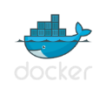
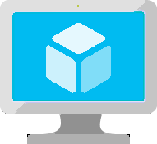


The Container Revolution
Docker image format for portability across environments
Virtual Machine
VM-independence for efficiency, scalability and resilience
Lightweight and agile for Cloud Native & Microservice architectures
Virtual Machine
+
Rich ecosystem of images with tools for development and operations
Containers

Slide 24

Choosing modernization strategy and technology
Modernize
Objectives |  |  |  |  |  | Options to consider
 |  | Rehost | Refactor | Rearchitect | Re-build
1 | Deliver new and breakthrough capabilities faster |  |  |  |  | PaaS, Serverless
 | Optimize for developer productivity, build apps faster
2 | Provide multichannel access, including mobile and IoT |  |  |  |  | PaaS, Serverless
 | Enable wider, secure access to applications, support range of devices
3 | More easily integrate with other web and cloud apps |  |  |  |  | PaaS, Serverless
 | Leverage PaaS, increase productivity with Serverless
4 | Enable business agility with continuous innovation |  |  |  |  | PaaS, Containers
 | Increase DevOps agility across teams
5 | Meet scalability requirements of existing apps more cost effectively |  |  |  |  | PaaS, Containers
 | Optimize application architecture for cloud scale
6 | Leveraging existing investments |  |  |  |  | PaaS, Containers
 | Across dev/ops, developer experience, tooling, infrastructure and deployed apps
7 | Free up data center space quickly |  |  |  |  | IaaS
 | Free up or consolidate resources for apps that must reside on-premises
8 | Reduce capital expenditure of existing applications |  |  |  |  | IaaS
 | Switch to pay-as-you-go model, realize better budget forecasting
9 | Achieve rapid time to cloud |  |  |  |  | IaaS
 | Allow migration with minimal architectural impact
Migrate
Note: Some of the objective might apply to more than one category of applications
Notes:
Speaker note:
While this can be a lot to consumer at one glance, our guidance is, from system of record to innovation, we recommend you move up the stack, from gaining just efficiency to a true innovation play.
Each customer is a unique snowflake. We get it. We offer portfolio assessment consultation service, tools and partners to help you decide the best path forward.

Slide 25
Multiple ways to Modernize, You can start at any stage
Migrate
Modernize & Innovate
ReHost
ReFactor
ReArchitect
ReBuild
Approach
Redeploy the application as-is to cloud
Minimally alter to take better advantage of cloud
Materially alter/decompose application to services
New code written with cloud native approach
Description
Reduce Capex
Free up datacenter space,
Quick cloud ROI
Faster, shorter, updates
Code portability
Greater cloud efficiency (resources, speed, cost)
Hyperscale
Independently scale and deploy parts of app
Mix technology stacks
Accelerate Innovation
Reduce TCO
Faster Development
Drivers
IaaS (VMs)
Containers
PaaS
Containers
PaaS
Microservices Platform
PaaS
Serverless
Technologies
Reduction in TCO approx. 30% on Average
PaaS : 466% ROI, 80% time saved, 5.91 M ROI, 50% faster deployments
Container : 13X more releases, 10X Cost Reduction, 65% Faster developer onboarding, 62% better availability
What customers are seeing
Notes:
Gartner IT Glossary.
Decision Point for Choosing a Cloud Application Migration Strategy, Gartner. Published: 29 March 2016
Source: “The Total Economic Impact Of Microsoft Azure PaaS,” a commissioned study conducted by Forrester Consulting, June 2016
Container ROI: State of App Development Survey: Q1 2016, Cornell University case study

Slide 26
Assessing your App Portfolio
Packaged LOB Apps
e.g. SAP, Microsoft Dynamics..
Custom Internal LOB Apps
e.g. payroll system
Custom External facing Apps
e.g. company website
New AI /Intelligent Apps
e.g. real-time bot messaging
App characteristics to consider when determining approach
Core Transactional vs. Differentiated or Innovative
Life Cycle of App
Regulatory, Compliance and other requirements..
Complexity of App
Architecture of existing apps

Slide 27
MSIT’s own Cloud adoption approach
Roadmap planning
From…
Office servers
Portals and SPS
Any relationship mgmt
Active Source Control & WIT
Data warehouses
Industry standard verticals
From…
Office servers
Portals and SPS
Any relationship mgmt
Active Source Control & WIT
Data warehouses
Industry standard verticals
…To
Office 365
SharePoint Online
CRM Online
VSO
ADL + PowerBI
Best 3rd-party SaaS
~30%
…To
Office 365
SharePoint Online
CRM Online
VSO
ADL + PowerBI
Best 3rd-party SaaS
Retire it, right-size, eliminate environments
Retire it, right-size, eliminate environments
~15%
Use or convert to a SaaS (1st or 3rd party) solution
Use or convert to a SaaS (1st or 3rd party) solution
Expose functionality in existing SaaS/PaaS solution
Convert to Azure PaaS solution
Optimize for and move to Azure IaaS
~35%
~10%
~5%
First to move
Basic web apps
Advanced portals
Any new solutions
Any re-architected solutions
Next to move
High I/O OLTP
Regulatory and high business impact
Hard or costly to Move
HVA Systems
PKI Systems
Legacy source control
No change, lift ‘n shift to IaaS
Remain on-premise
<5%
Azure IT Roadmap
Notes:
Presentation Notes:
This slide shows the outcome of the portfolio evaluation process. It shows the output and results of portfolio evaluation, and how the vast portfolio is divided up and slated for adoption. It also shows that half of the portfolio consists of custom LOB apps.
Speaker Notes:
After analyzing our portfolio, we’ve determined rough distributions of application placement in the cloud.
As mentioned previously, this has been a great opportunity to retire applications and streamline our portfolio. We see 30 percent of our portfolio here. 1,300 apps, very aggressive about addressing capability duplication.
Retire: Evaluate whether we can retire or consolidate functionality into one app or service line.
Rightsize: IT is good at overprovisioning and underutilizing. This is reflected in utilization rates, and cold/frozen servers. Moving to the cloud is an opportunity to look at performance and capabilities of existing physical servers/VMs, and decide where to land in Azure.
Eliminate environments: Thousands of physical servers and VMs have been eliminated.
Go after cold (< 5% server utilization in 90 days) and frozen (< 20% server utilization in 7 days) assets. Get smart about how we use what we bought.
For sustain apps (no further investment), look to see if app has pre-production environments such as Dev or Test, and turn them off. This can realize a 90% cost savings.
We see 15% of our portfolio being replaced by a SaaS solution (move from Office servers to Office 365)
Adopt commodity solutions, such as Office 365, SharePoint Online, some third-party solutions, as they become available.
Transition functionality from shadow IT to retail solutions.
Complex and customized LOB applications make up 50% of our portfolio. Within that 50%:
35% have been identified as “first to move.” These are basic web apps, or re-architected solutions.
10% have been identified as “next to move.” These are being Moved to IaaS. We are more aggressive than customers, focusing on “what’s moving next?” Don’t hesitate, move apps and functionality, and make it work.
5% have been identified as “hard or costly to move.” They fail, and fail fast.
Some apps have been moved back on-premises. Why?
Azure capabilities need to develop, or need very large VM to make it work.
They can’t meet SLAs, and can’t be remediated.
Proof of concept, for example waiting for internal security reviews, due diligence, and so on.
Less than 5% of apps remain on premises.
Notes on rightsizing
Take the opportunity to rightsize as you go in. Scale up and out. Acquire technical “debt” from legacy apps, which were designed to work in on-premises environments, where latency is low.
Moving to the cloud, some considerations, such as latency, may no longer be an issue in the cloud environment. On the other hand, there may be new issues, such as the speed of light, when workloads are moved further away.
Like an onion, the center is a server. It is unlikely that an enterprise IT app is a single server. Usually multiple servers.
Move one server into public cloud? Adding 50 megaseconds can have an impact. There are upstream and downstream dependencies on service lines. For example, the store experience is an app, sales engine, and fulfillment engine. The move may affect customers, SLAs with business partners, etc.
Start with smallest computing capacity that you can make it work in; it is easier to move to larger sizes if needed.
This is a big cultural change. IT usually overprovisions computing capacity.
You must continue to monitor environments. For example, if writing an app for PaaS, it doesn’t automatically rightsize itself.
Process for approaching complex/customized LOB apps
Expose functionality in existing SaaS/PaaS solution. May have to re-architect or rebuild.
Convert to Azure PaaS solution.
Optimize and perform bulk operation, move to Azure IaaS VM.
No change, lift and shift to IaaS. Move the existing IT footprint to Azure. Re-create/copy to Azure, or move from on- to off-premises.

Slide 28
Azure. Cloud for all.
Productive
Hybrid
Intelligent
Trusted
Notes:
Azure. Cloud for all.
These 4 pillars represent the main value proposition for what differentiates Azure from the competition.
As you can see in the proof points, these are the reason why customers choose Microsoft, because of the unique value that we provide in a productive, hybrid, intelligent, and trusted cloud.
With Azure, you can do—or be—all of these things.
Productive
Get unparalleled developer productivity with integrated tools from mobile DevOps to serverless computing.
Learn about accelerating innovation
Hybrid
Develop and deploy where you want, with the only consistent hybrid cloud on the market. Extend Azure on-premises with Azure Stack.
Learn about our consistent hybrid cloud
Intelligent
Create intelligent apps that delight with data-driven experiences. Go quickly from concept to release with Azure data services and artificial intelligence, from image recognition to bot services.
Learn about intelligent apps
Trusted
Join startups, governments, and 90 percent of Fortune 500s that trust the Microsoft Cloud for security, privacy, transparency, and the most compliance coverage of any cloud provider.

Slide 29





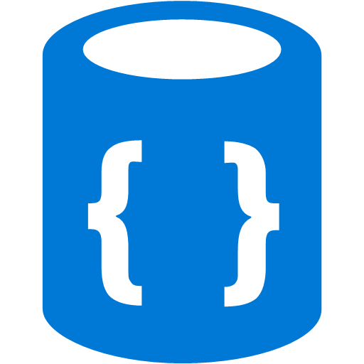
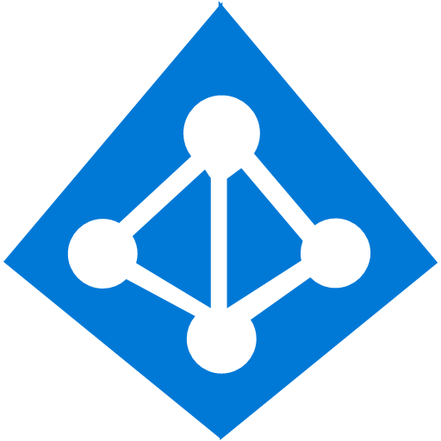
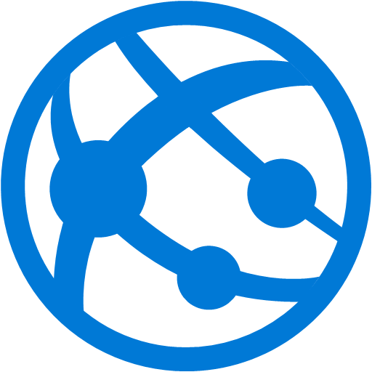



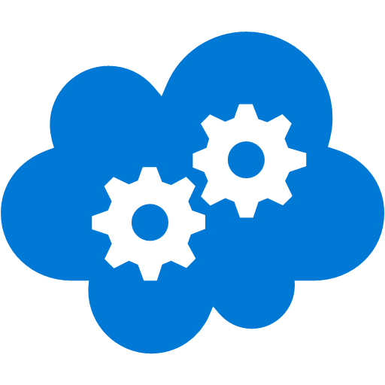
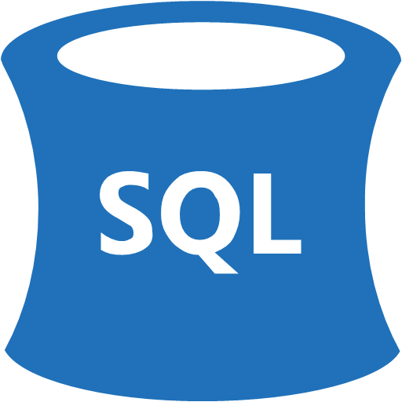


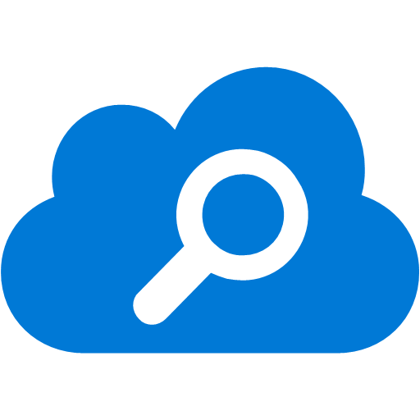


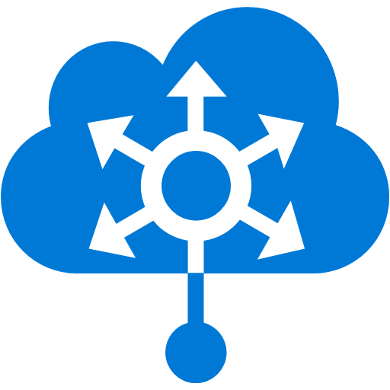


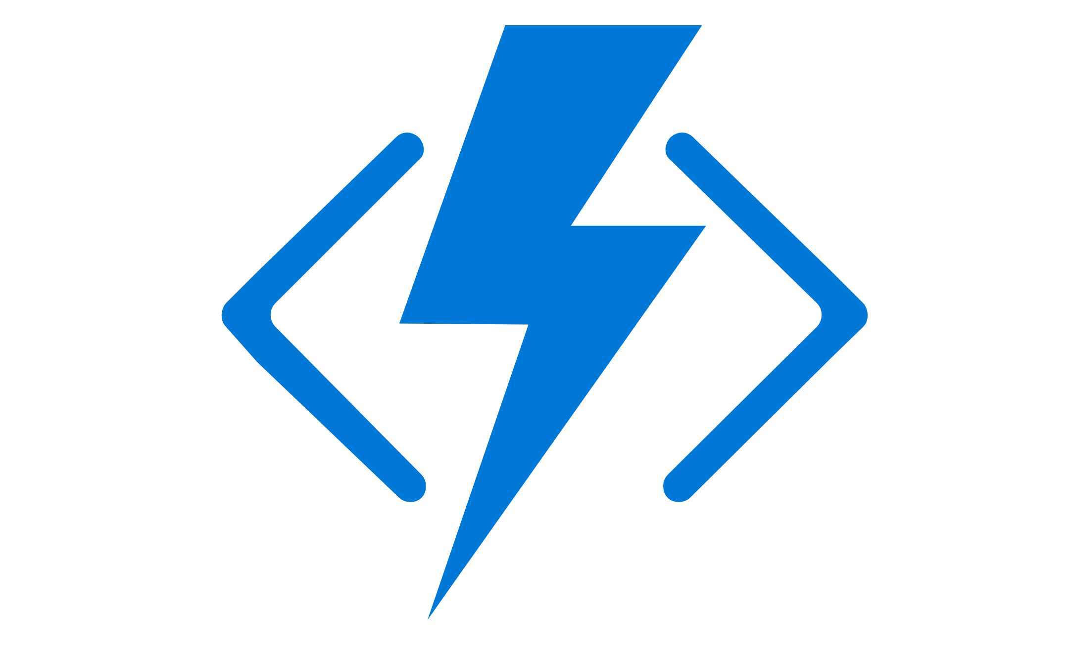
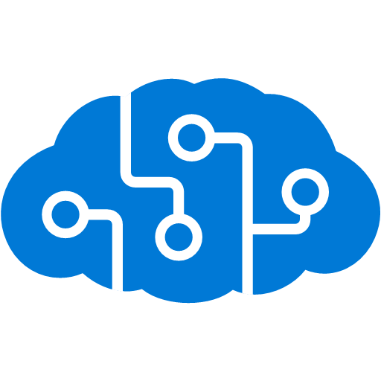


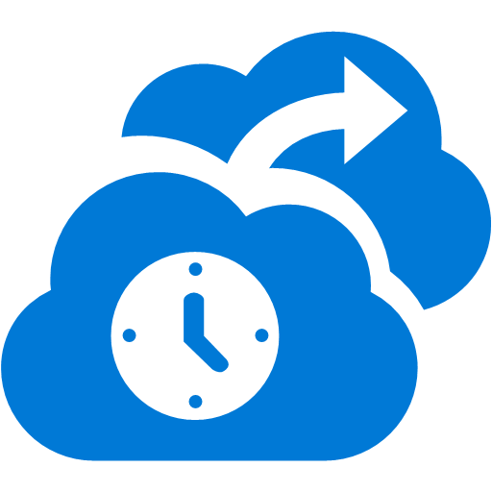

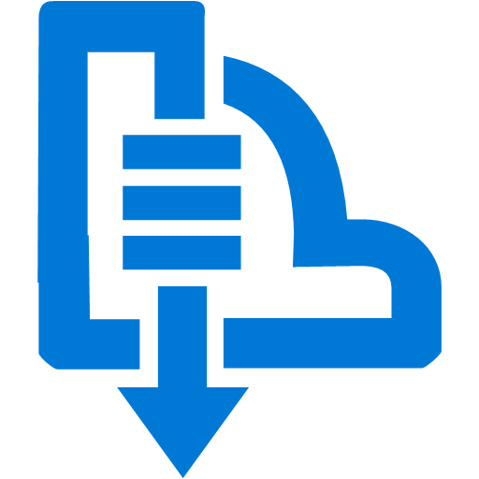


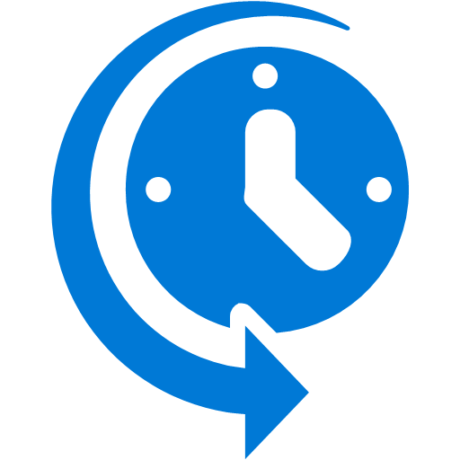



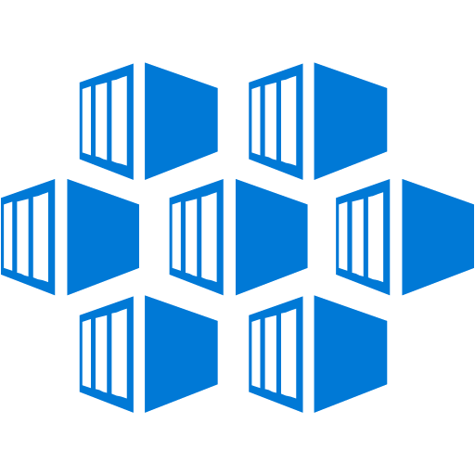

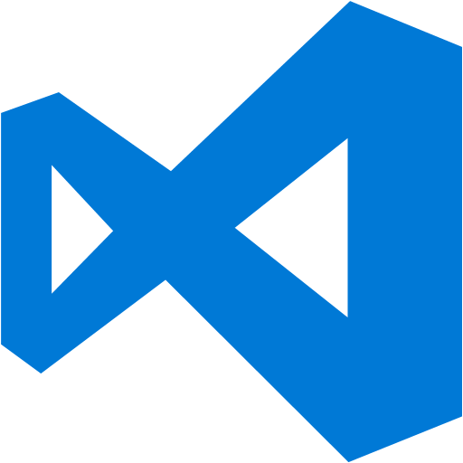



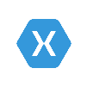
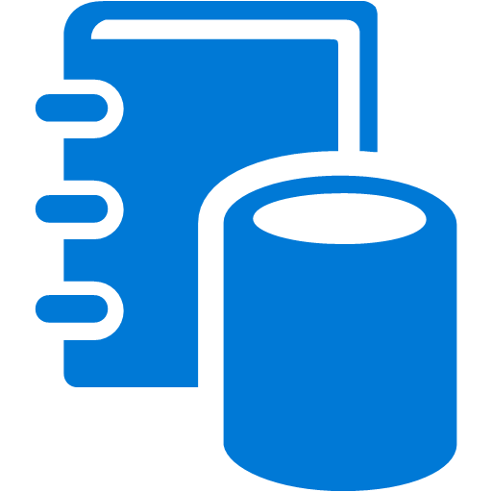



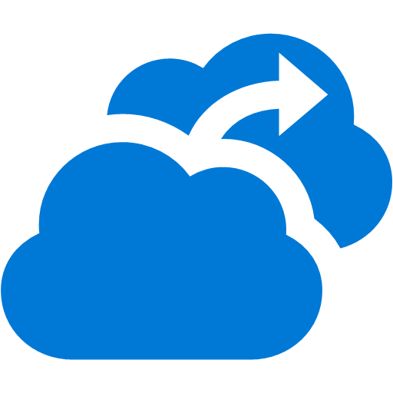


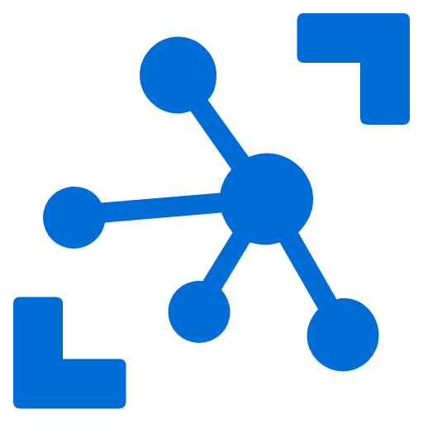
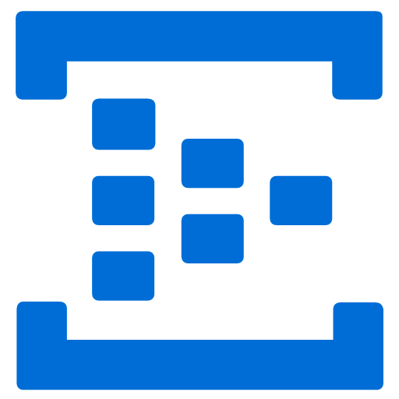


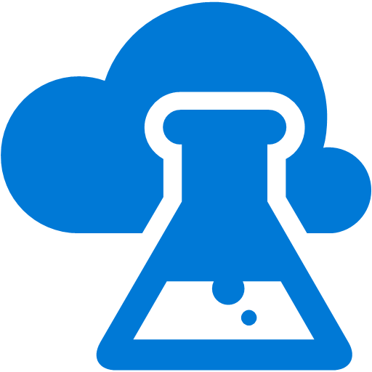
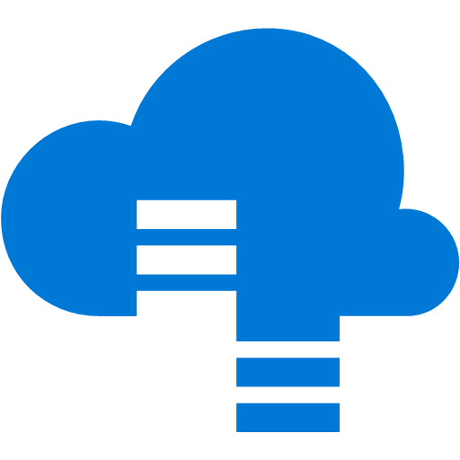
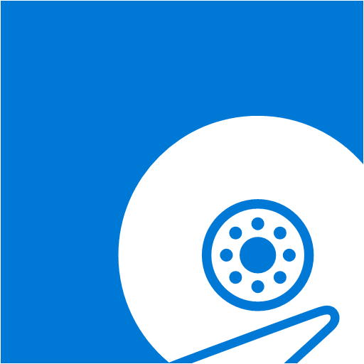


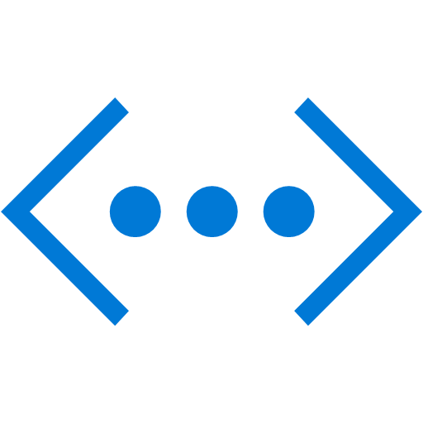
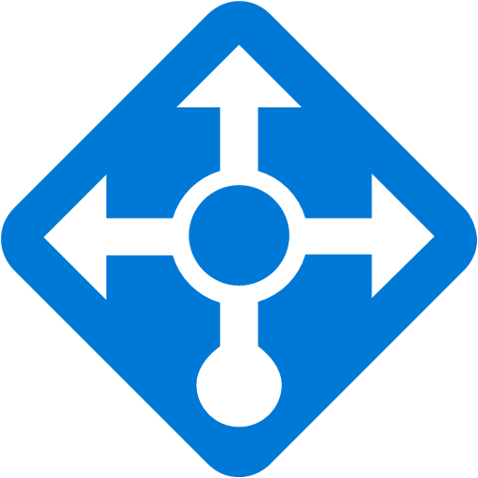

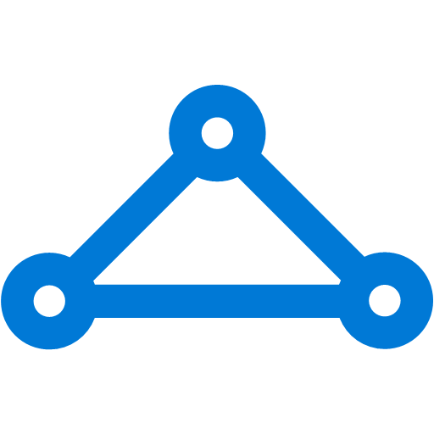
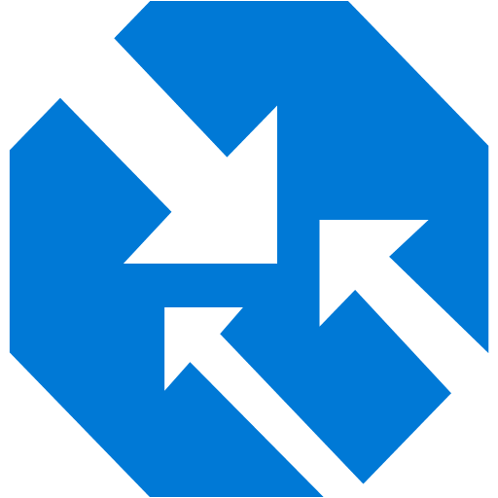

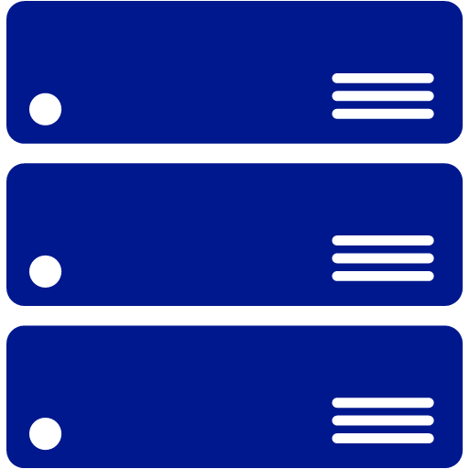
Security
& Management
Platform Services
Security & Management
Hybrid
Cloud
Hybrid
Media & CDN
Application Platform
Data
Media & CDN
Apps Service
Data Service
Security Center
Media Services
Media Analytics
Content Delivery
Network
SQL
Database
SQL Data
Warehouse
DocumentDB
Azure AD
Health Monitoring
Web
Apps
Mobile
Apps
Portal
SQL Server
Stretch Database
Redis
Cache
Storage
Tables
Azure
Search
AD Privileged
Identity
Management
INTEGRATION
EAI / ESB
Azure Active
Directory
Integration
API
Apps
Cloud
Services
API
Management
BizTalk
Services
Cognitive / Inteligent Service
Domain Services
Azure AD
B2C
Service
Fabric
Notification
Hubs
Intelligence
Multi-Factor
Authentication
Logic
Apps
Service Bus
Functions
Cognitive Services
Bot Framework
Cortana
Backup
Analytics & IoT
Dev Service
Analytics & IOT
Service
Automation
Compute Services
Developer Services
Operational
Analytics
Compute Services
Scheduler
HDInsight
Machine
Learning
Stream Analytics
Container
Service
VM
Scale Sets
Visual Studio
Mobile
Engagement
Import/Export
Key Vault
Data
Catalog
Data Lake
Analytics Service
Data Lake Store
Batch
RemoteApp
VS Team Services
Xamarin
Azure Site
Recovery
Store/
Marketplace
Event
Hubs
Data
Factory
Power BI
Embedded
Application
Insights
HockeyApp
IoT Hub
Dev/Test Lab
StorSimple
VM Image Gallery
& VM Depot
Infrastructure Services
IAAS Compute Storage
Compute
Storage
Networking
Virtual Machines
Containers
Blob
Queues
Files
Disks
Virtual Network
Load Balancer
DNS
Express
Route
Traffic Manager
VPN Gateway
App
Gateway
Datacenter Infrastructure (50 Regions, 40 Online)

Slide 30
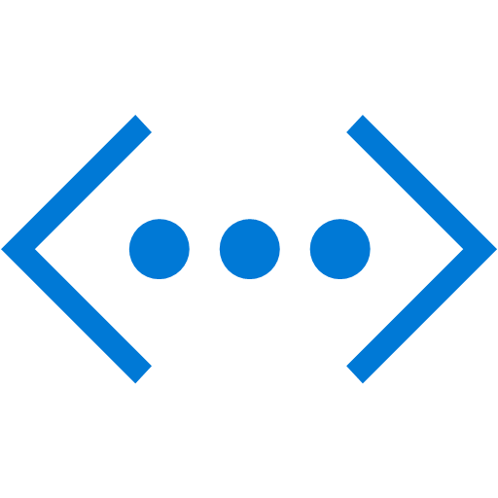
Platform Services
Security & Management
Hybrid
Cloud
Media & CDN
Application Platform
Data
Security Center
Media Services
Media Analytics
Content Delivery
Network
SQL +MySQL
PostGre
Database
SQL Data
Warehouse
DocumentDB +
MongoDB
Azure AD
Health Monitoring
Web
Apps
Mobile
Apps
Portal
SQL Server
Stretch Database
Redis
Cache
Storage
Tables
Azure
Search
AD Privileged
Identity
Management
Azure Active
Directory
Integration
API
Apps
Cloud
Services
Azure AD
B2C
API
Management
BizTalk
Services
Intelligence
Domain Services
Service
Fabric
Notification
Hubs
Multi-Factor
Authentication
Logic
Apps
Service Bus
Functions
Cognitive Services
Bot Framework
Cortana
Backup
Automation
Developer Services
Analytics & IoT
Compute Services
Operational
Analytics
Scheduler
HDInsight
Machine
Learning
Stream Analytics
Container
Service
VM
Scale Sets
Visual Studio
Mobile
Engagement
Import/Export
Key Vault
Data
Catalog
Data Lake
Analytics Service
Data Lake Store
Batch
RemoteApp
VS Team Services
Xamarin
Azure Site
Recovery
Store/
Marketplace
Event
Hubs
Data
Factory
Power BI
Embedded
Application
Insights
HockeyApp
IoT Hub
Dev/Test Lab
StorSimple
VM Image Gallery
& VM Depot
Infrastructure Services
Compute
Storage
Networking
Virtual Machines
Containers
Blob
Queues
Files
Disks
Virtual Network
Load Balancer
DNS
Express
Route
Traffic Manager
VPN Gateway
App
Gateway
Datacenter Infrastructure

Slide 31
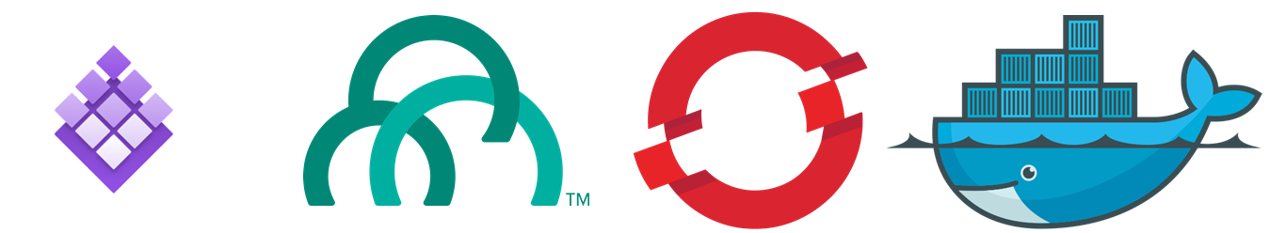
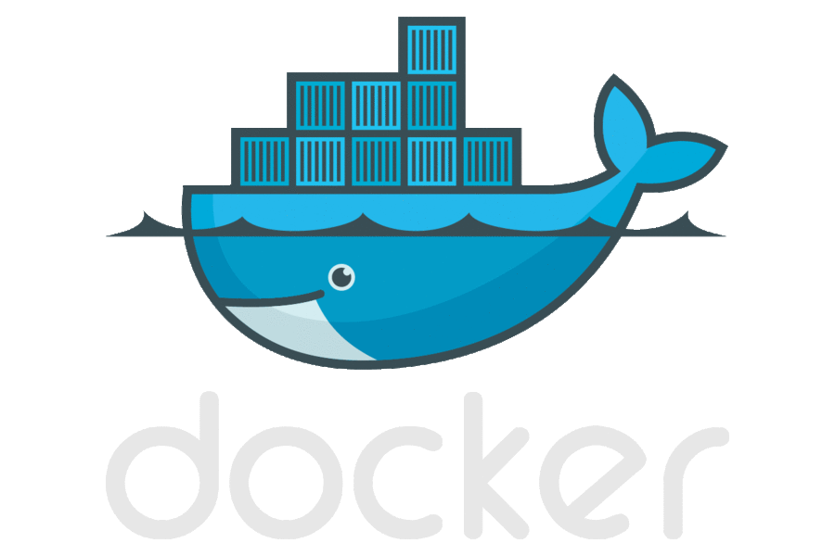
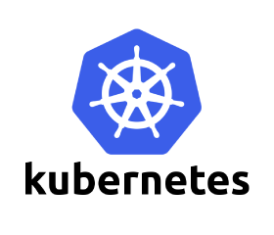
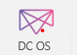
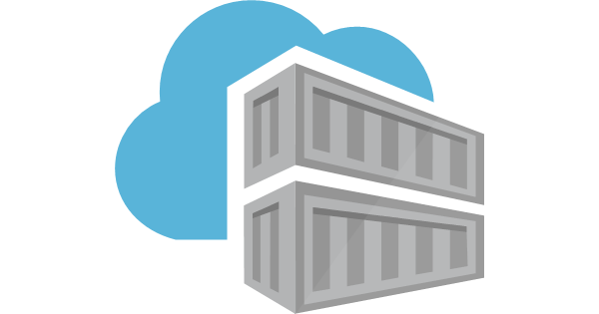




Providing choice to Customers
Options of compute
Leverage the Azure platform designed for your application needs
Keep using the platform of your choice, running great on Azure
PaaS Services & Serverless
Azure App Service
Redhat Openshift Container Platform
Pivotal Cloud Foundry
Functions
managed container orchestrators
Service Fabric
Azure Container Service (AKS)
Icon showing
Docker Swarm
Kubernetes
DIY with raw compute
Windows VMs
Linux VMs
Windows VMs
Linux VMs
Secure image
management
Azure Container Registry
Docker Hub, private registry
Choice of developer
tools & clients
Visual Studio tools
InteliJ
Ma en
Jenkins
Notes:
Containers are becoming the common currency of deployment and have fundamentally changed the way developers develop their applications, the way applications are deployed, and the way system administrators manage their environments.
Containers offer a broadly accepted and open standard, enabling simple portability between platforms and even between clouds.
Azure offer you the flexibility to use tools that your teams are familiar with. You can use Azure Container Registry to store and manage container images across all types of Azure deployments and deploy them using compute option that works best for your needs.
If you’re getting started with containers, Azure Container Instances (ACI) provide a simple experience to get started with containers in the cloud, enabling you to quickly create and deploy new containers with only a few simple parameters. For web apps, we now support containers in App Service which offers built-in CI/CD and a fully managed platform to run container based web applications.
For advanced applications, you would typically need a product that supports container orchestration. We support all the leading container & orchestrators we have in the marketplace.
Azure Service Fabric is one such platform we also use to run many of our own services such as Skype for Business, Dynamics 365. It supports container orchestration, both for Windows and Linux, and can be used to run large scale applications.
One of our core tenets is to provide to provide choice and Microsoft was one of the first to support the leading open source container orchestrators, including Kubernetes, Docker Swarm, and DC/OS, in the cloud.

Slide 32

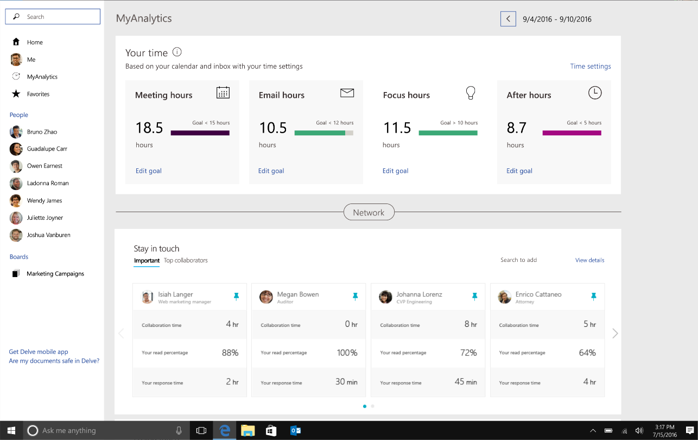
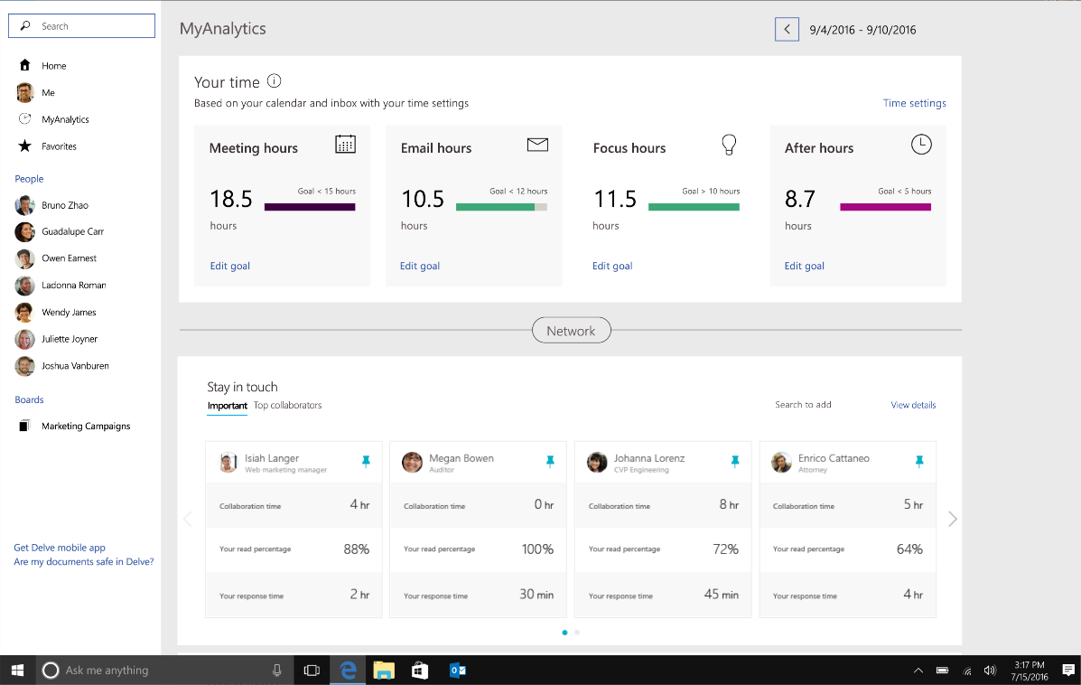
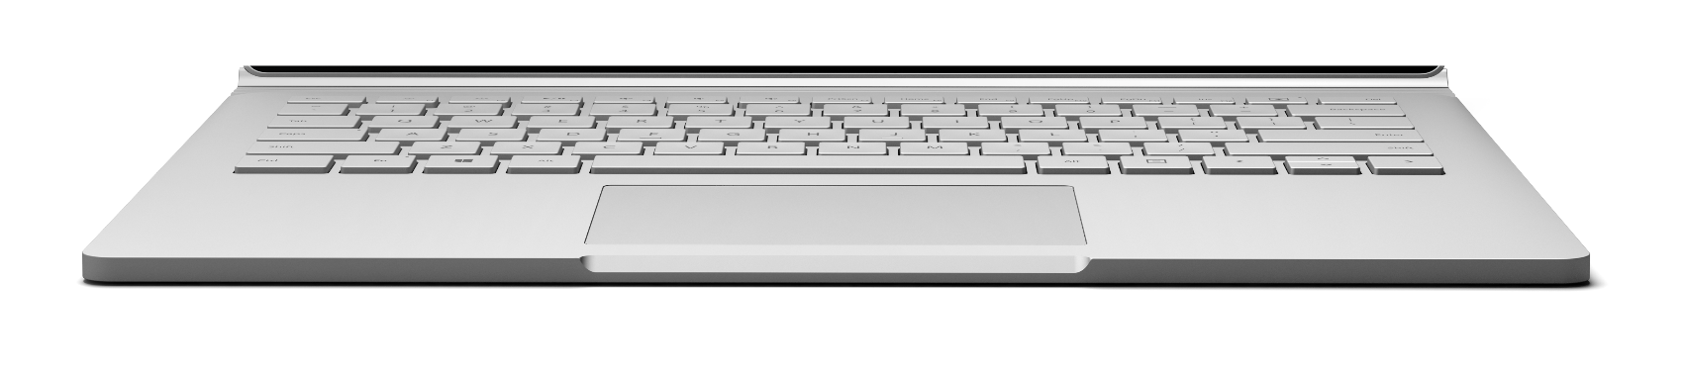
Transactions
Authentication
Search
Streaming
Integration
Web application
Caching
API
Storage
Static Files
Database
Application Server

Slide 33
Transactions
Authentication
Search
Streaming
Integration
Web application
Caching
API
Storage
Static Files
Database
Application Server

Slide 34
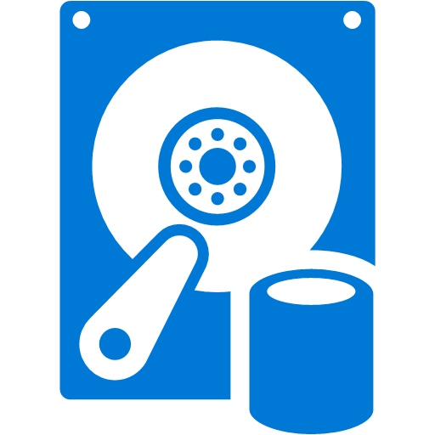
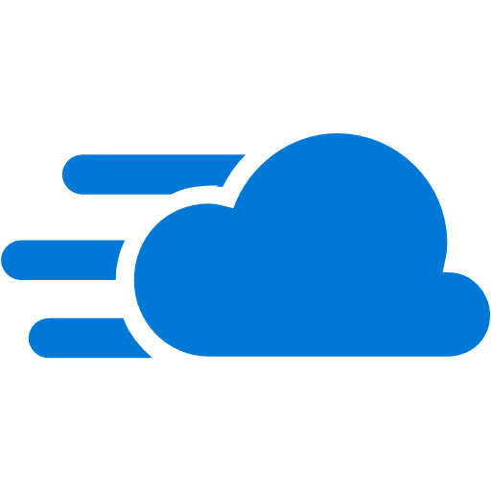
IaaS Architecture
User
Media Encoding
3rd party integration PIM / external Data
Active MQ
CDN
Traffic Manager
Web App
Redis Cache
Data Layer
Elastic Search

Slide 35

PaaS Architecture
User
Media Services
3rd party integration PIM / external Data
Search
Service Bus
CDN
Traffic Manager
Web App
Redis Cache
Storage
Data Layer

Slide 36
DevOps with Azure DevOps

Slide 37
The converged DevOps lifecycle
Plan + Track
Release
Development
Production
Develop + Test
Monitor + Learn

Slide 38
Common software delivery challenges
Low Deployment
Frequency
High Lead Time
For Changes
!
High Change Failure
Rate
Long Mean Time to
Recover

Slide 39

What is DevOps?
People. Process. Technology.
DevOps is the union of people, process, and technology to enable continuous delivery of value to your end users.
“
Plan & Track
Agile Planning
Dashboards
Kanban Boards
Taskboards
Build & Test
Git Source Control
Modern Code Workflow
Continuous Integration
Continuous Testing
Package Management
Open Source Compliance
Develop + Test
Plan + Track
Continuous
Delivery
Monitoring & Operations
Telemetry
Diagnostics
Analysis
Compliance
Release
Deployment
Deployment of app and infrastructure
PaaS, IaaS and Containers
Monitor + Operate
Notes:
DevOps is the union of people, process and technology to enable the continuous delivery of value to your end customers

Slide 40
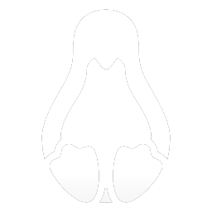

Tools and services for any developer, any app
Windows
Linux
iOS
Android
.NET
C++
JavaScript
PHP
Python
Node.js
R
Cordova
Unity

Slide 41





Introducing Azure DevOps
Azure Boards
Azure Pipelines
Azure Repos
Deliver value to your users faster using proven agile tools to plan, track, and discuss work across your teams.
Build, test, and deploy with CI/CD that works with any language, platform, and cloud. Connect to GitHub or any other Git provider and deploy continuously.
Get unlimited, cloud-hosted private Git repos and collaborate to build better code with pull requests and advanced file management.
Azure Test Plans
Azure Artifacts
➔
Test and ship with confidence using manual and exploratory testing tools.
Create, host, and share packages with your team, and add artifacts to your CI/CD pipelines with a single click.
https://azure.com/devops
Notes:
So does TFS

Slide 42
DevOps at Microsoft
Azure DevOps is the toolchain of choice for Microsoft engineering with over 90,000 internal users
➔
https://aka.ms/DevOpsAtMicrosoft
372k
Pull Requests per month
4.4m
Builds per month
5m
Work items viewed per day
78,000
Deployments per day
2m
Git commits per month
500m Test executions per day
500k
Work items updated per day
Data: Internal Microsoft engineering system activity, August 2018
Notes:
Enterprise scale

Slide 43


Plan & Track Work
Source Code Management
Package Management
Quality Management
Cross-platform Build
Continuous Deployment
Release Management
Feedback Management
Application Telemetry
Extend, Customize & Integrate
Azure Devops
Team Foundation Server

Slide 44
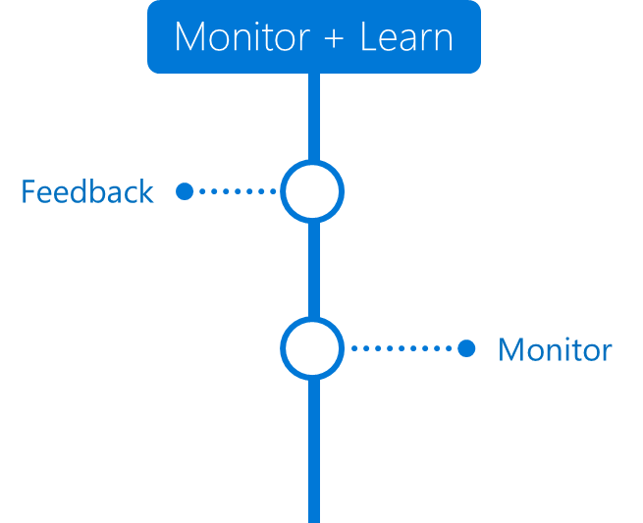
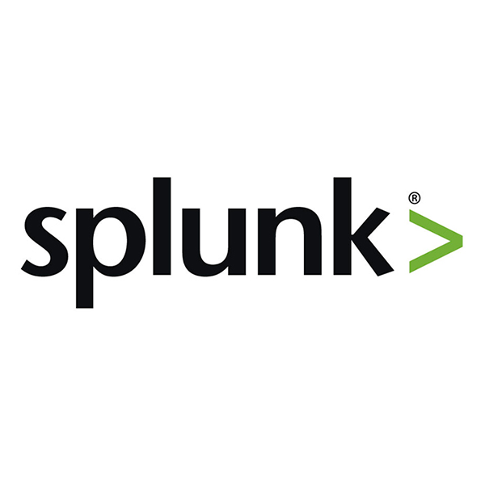
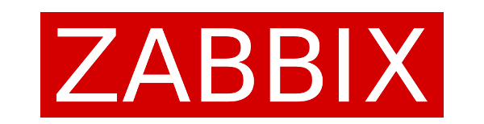
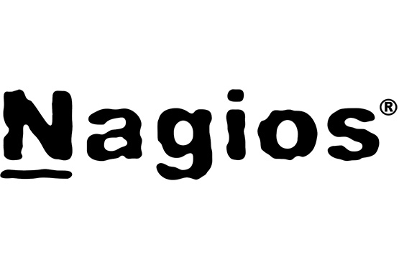
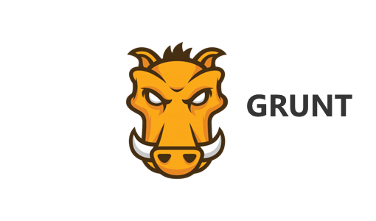
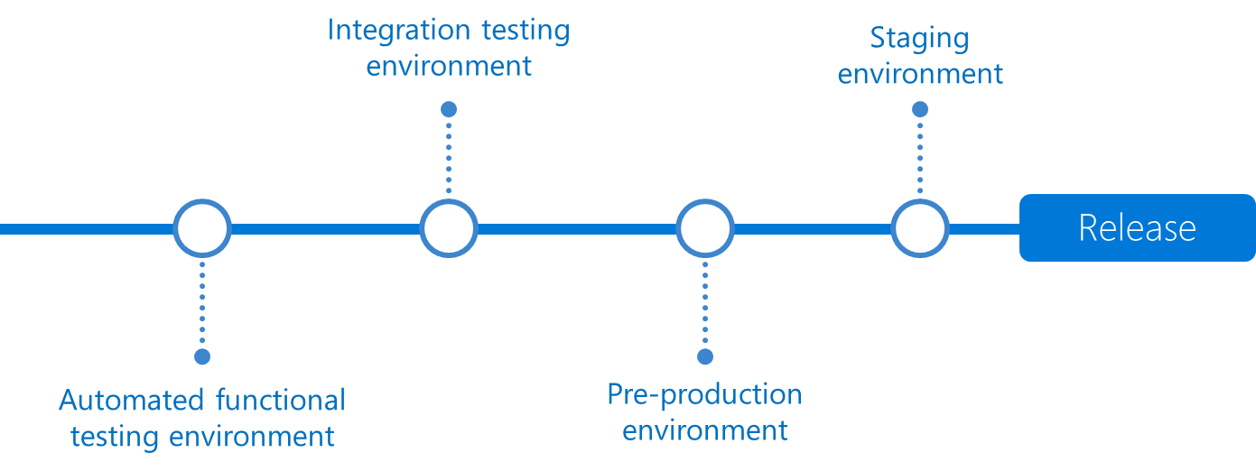
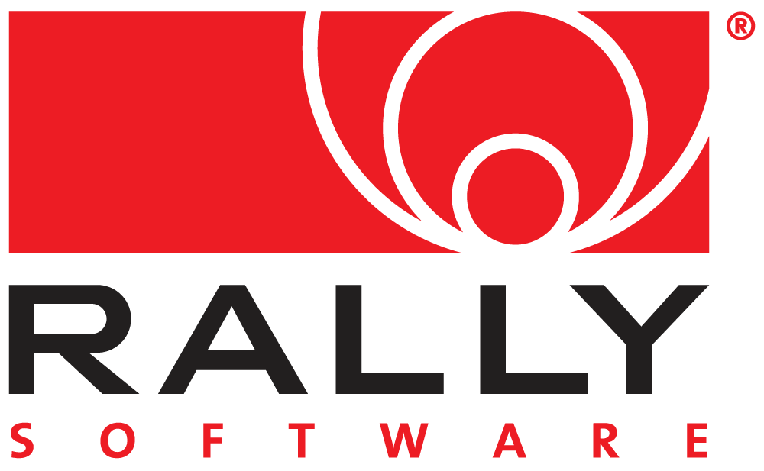
























Azure DevOps and OSS
DevOps
DevOps

Slide 45







DevOps Vision on Azure
Container Service
Run, Manage,
Integrate
Service Fabric
Source Code Control
(SCC)
Build/CI,
Integrate,
Test
CD, Deploy
App Services
Batch
Azure Container Registry
Functions
…
Inner-Loop
…
Run
Monitor and Diagnose
Code
Validate
Debug
Analyze, Understand, Improve
Notes:
Ouvrir avec la liberté des plateformes…

Slide 46
12 Factor App
1. CODEBASE
One codebase tracked
in SCM, many deploy
4. BACKING SERVICES
Treat backing services as attached resources
7. PORT BINDING
Export services via port binding
10. DEW PROD PARITY
Keep dev, staging, prod as similar as possible
11. LOGS
Treat logs as event stream
12. ADMIN PROCESSES
Run admin / mgmt tasks as one-off processes
2. DEPENDENCIES
Explicitly declare isolate dependencies
3. CONFIGURATION
Store config in the environment
5. BUILD, RELEASE, RUN
Strictly separate build and run stages
6. PROCESSES
Execute app as stateless processes
8. CONCURRENCY
Scale out via the process model
9. DISPOSABILITY
Maximize robustness & graceful shutdown

Slide 47

Cloud Design Patterns
Cloud Design patterns are useful for building reliable, scalable, secure applications in the cloud.
https://docs.microsoft.com/en-us/azure/architecture/patterns/

Slide 48
Cloud Design Patterns
Cloud Design patterns are useful for building reliable, scalable, secure applications in the cloud.

